Slide 1
Lightweight Impact Analysis using Island Grammars
Leon Moonen
CWI, P.O. Box 94079
1090 GB Amsterdam, The Netherlands
http://www.cwi.nl/~leon/ IEEE 2002 Presentation by – Sanket Prabhu (srp140430)

Slide 2
Impact Analysis
Planning and estimation of software maintenance
Traditional Impact analysis was too expensive
Need for Lightweight Impact Analysis

Slide 3
Introduction
70% of software budgets are spent on software maintenance
Understanding the software system that has to be maintained and determining the impact of proposed change requests
Time and cost increases with traditional impact analysis
Goal is to reduce use of resources and development time

Slide 4

Problem Description
Estimating in which parts of the software portfolio of a large Dutch Bank changes have to be made when
9 digit account number 10 digit account number
Supply of unused numbers were running out
Prefixing existing numbers with 0 and using prefixes 1…9 for fresh numbers

Slide 5
Aim to solve the Problem
Impact Analysis based on Island grammar
Focus is more on short development time and enabling quick feedback for the complete portfolio
Handle code that contains mixture of GOOD and BAD account numbers

Slide 6
Impact Analysis Approach
Patterns
Classification
Anti-patterns
Presentation
Tool support

Slide 7
1. Patterns
Search is partially based on pattern matching on the name of the variables
For ex.
ACCOUNTNR
ACCNR
ACC-NO
GNR (used for giro number)

Slide 8
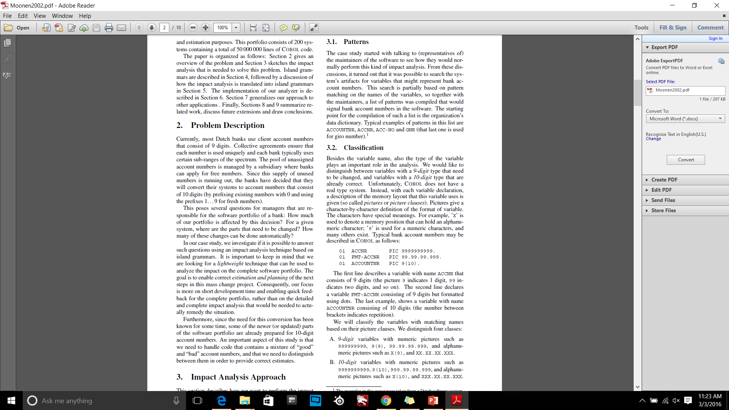
2. Classification
Type of variable also plays an important role in analysis
A description of the memory layout that variable uses(Pictures)

Slide 9
3. Anti-patterns
Names that match with patterns but not used for account numbers
False positives
Variable names matches patterns and anti-patterns then the variable is rejected
Iterative approach. Precision increases at each iteration

Slide 10
4. Presentation
Pages displaying statistics and pie charts summarization the analyzing results
Occurrences of account numbers
Identifying false positives

Slide 11
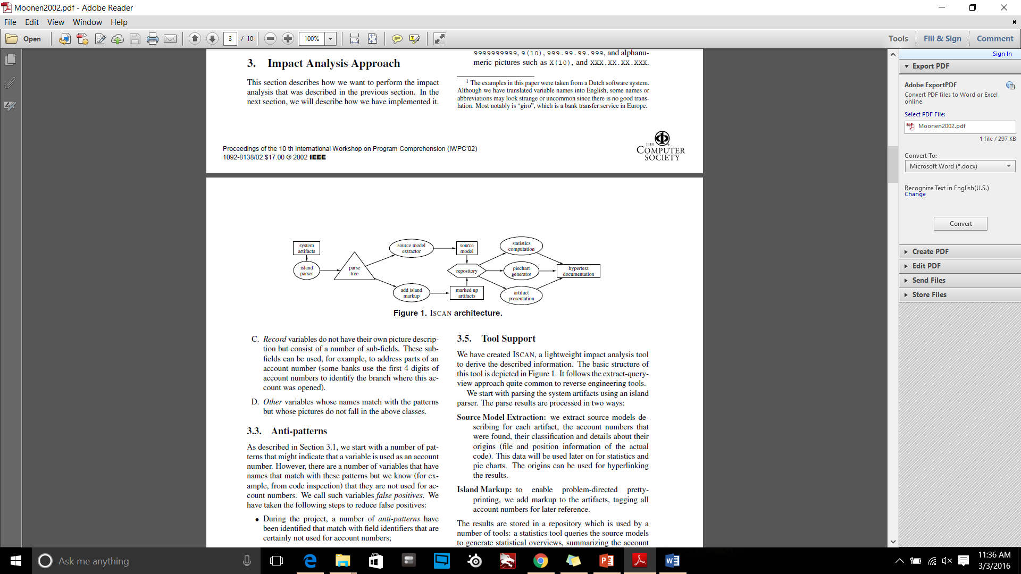
5. Tool Support

Slide 12
Island Grammars
Detailed productions that describe the language constructs that we are particularly interested in(island).
Liberal productions that catch the remainder of the input
Parsing with lexical approaches by analyzing interesting parts and ignoring non-interesting parts

Slide 13
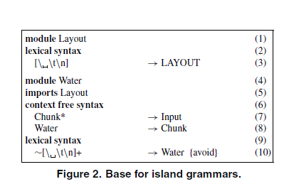

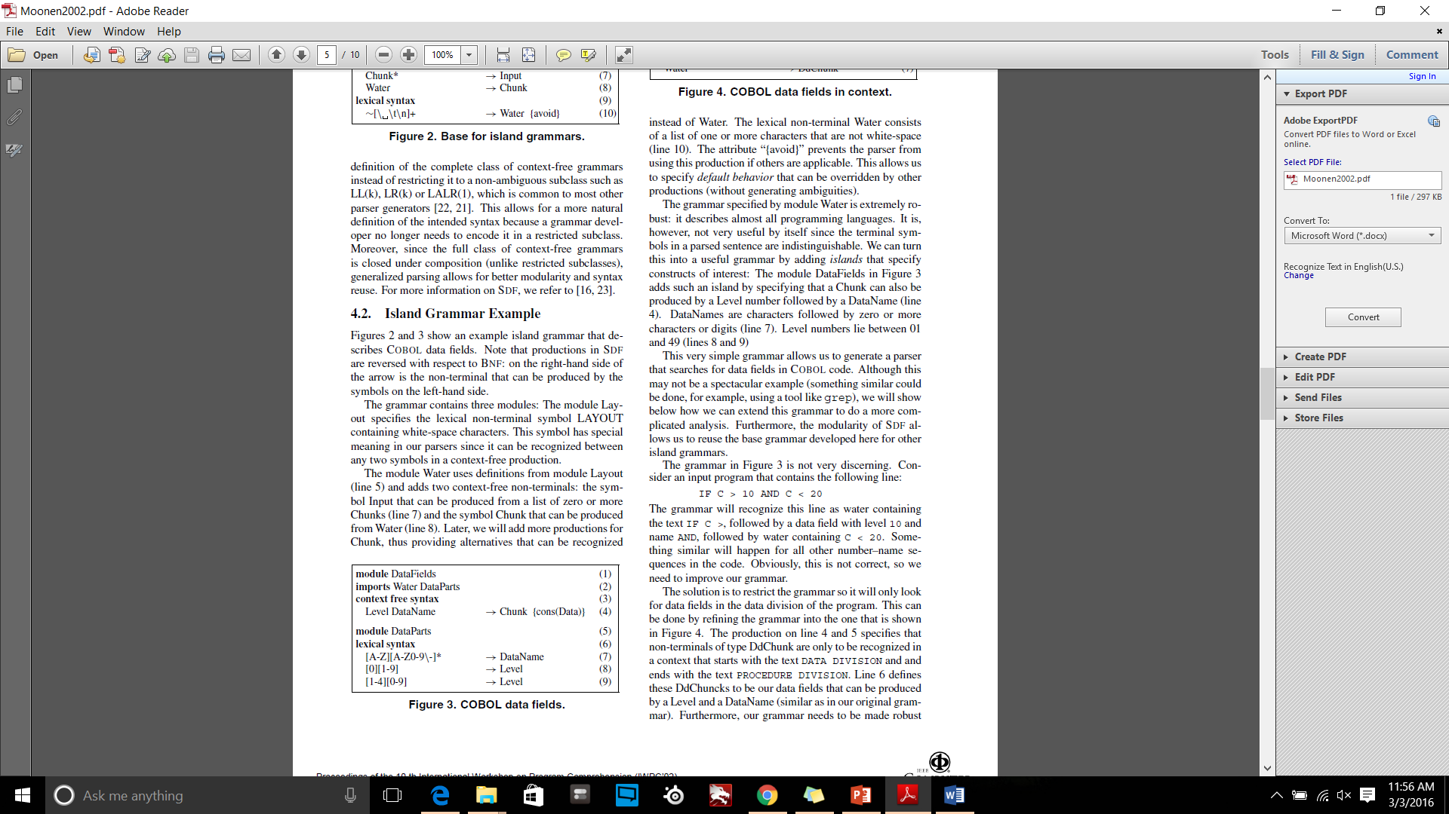
Island Grammar Example
EX:
IF C > 10 AND C < 20

Slide 14
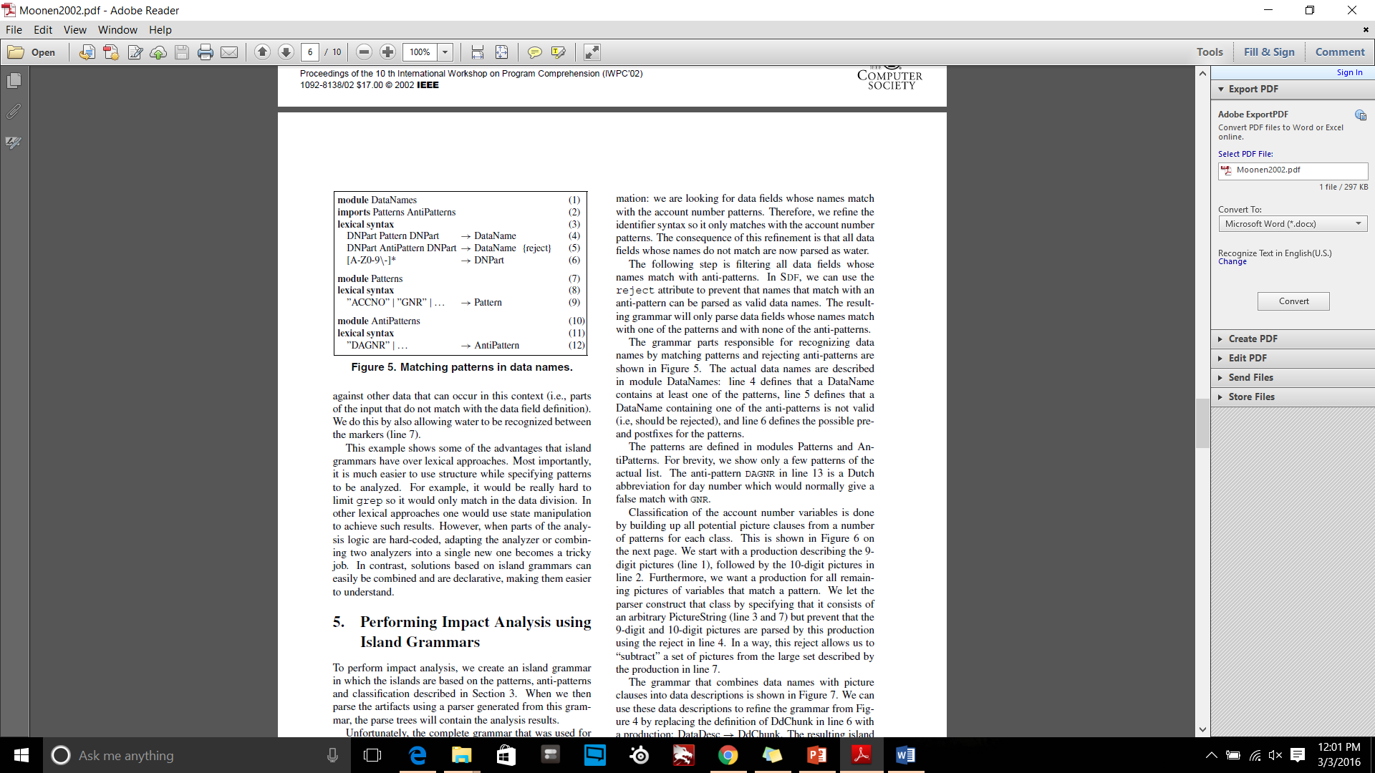
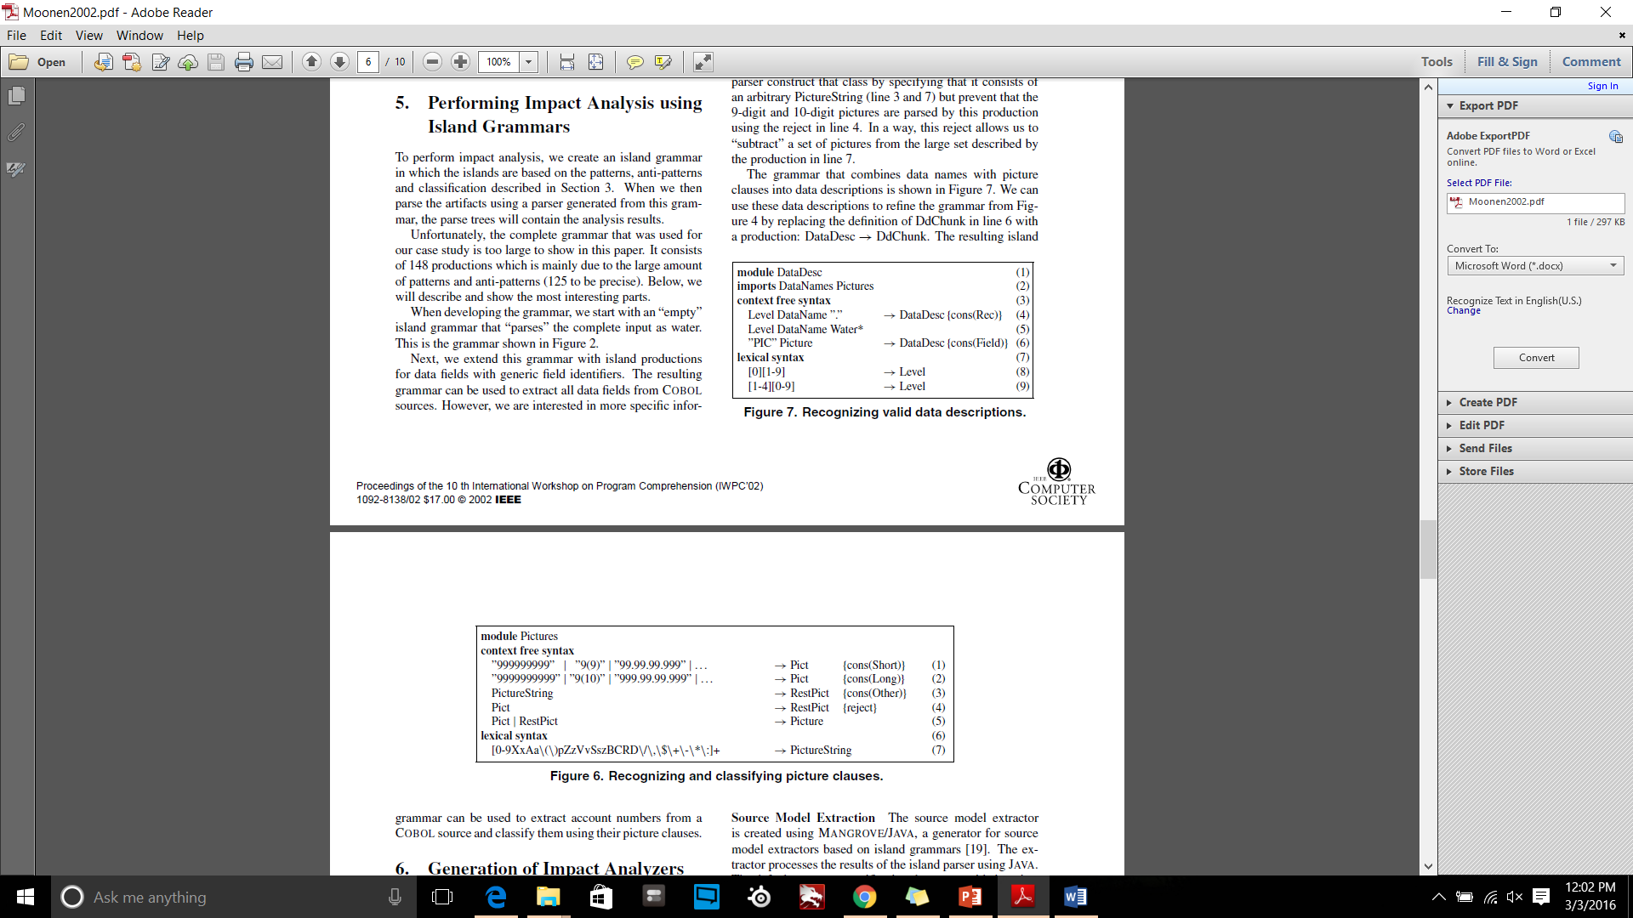
Performing Impact Analysis using Island Grammars

Slide 15
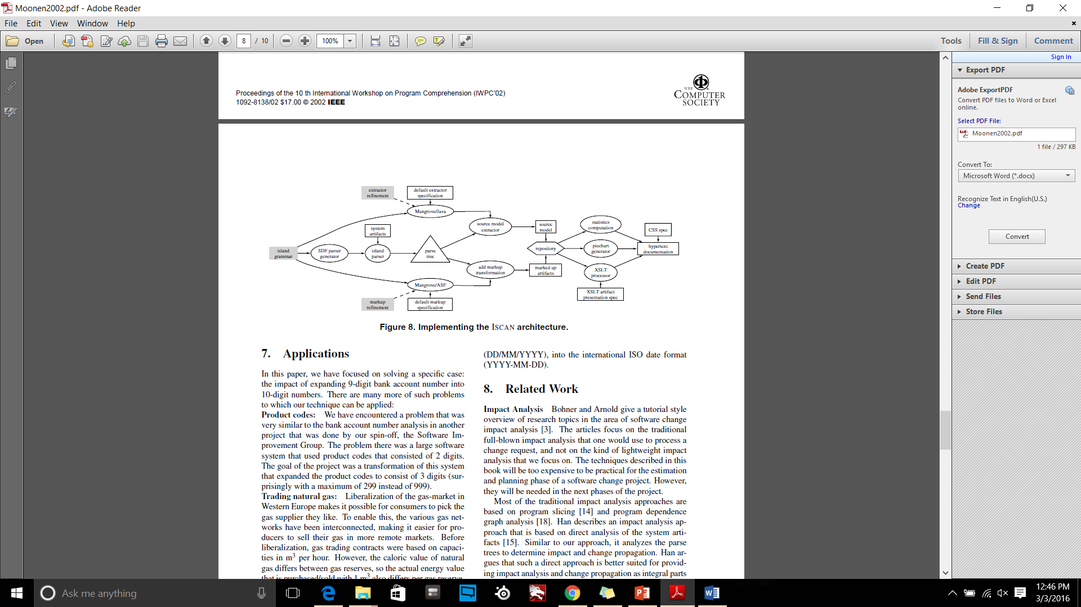
Generation of Impact Analyzers
Source Model Extraction
Island Markup
Presentation

Slide 16
Applications
Product codes
Trading natural gas
Selling natural gas
Date format conversion

Slide 17
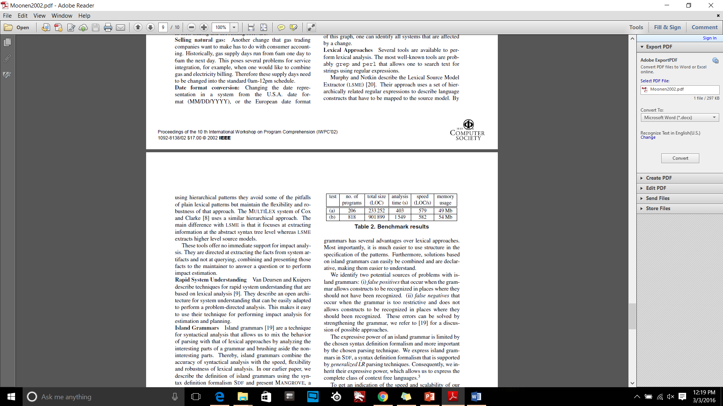
Conclusion: Evaluation
Island grammar has several advantages over lexical approaches
Easier to use structure in the specification of the patterns
Solutions based on island grammar are easier to understand
System Specification:
AMD Athlon processor (1.2 GHz) and 512 Mb main memory running linux 2.4.9-12

Slide 18
Question
According to you, Why it is hard to parse the artifacts using common parser based approaches

Slide 19


